Slide 1
Twitter Handles of Alexandria Ocasio-Cortez
Naga Vamsi Krishna Pabbisetty
FEB-27-2019

Slide 2
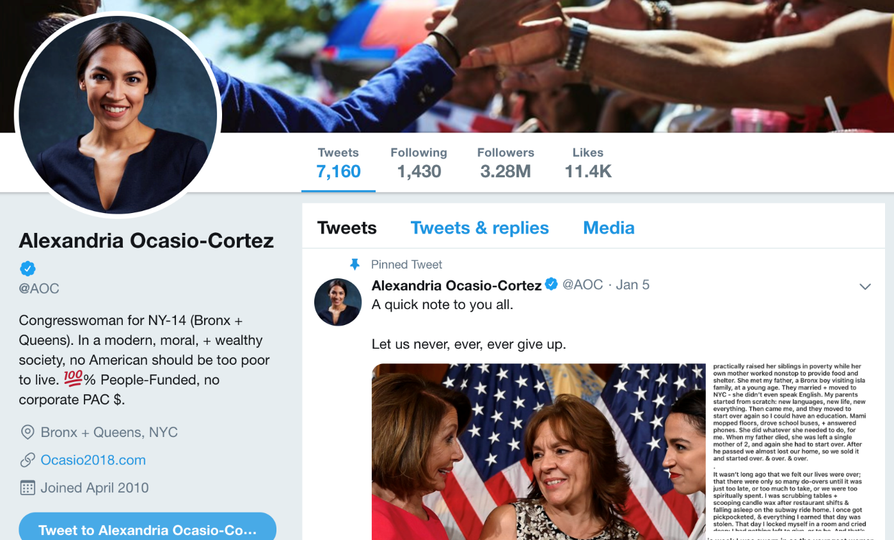
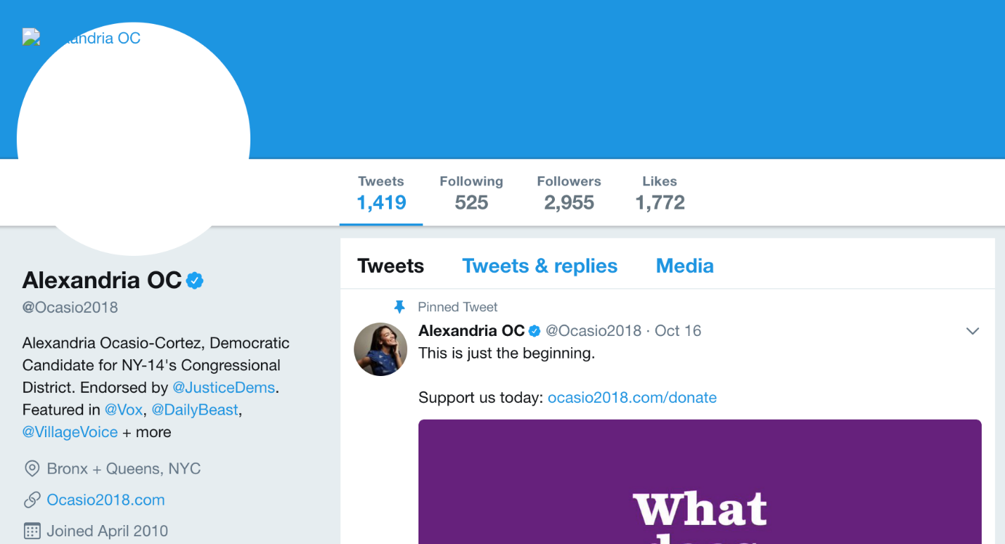


Alexandria Ocasio-Cortez
URL: https://twitter.com/AOC?lang=en
URL: https://web.archive.org/web/20171018034720/https://twitter.com/ocasio2018?lang=en

Slide 3
Rise to Fame
Became a Member of the U.S. House of Representatives from New York’s 14th District and started office in January 2019
Won against Rep. Joe Crowley, in office from 1999 to 2019, 7th and 14th districts, New York
Before running for Congress, she served as an educational director for the 2017 Northeast Collegiate World Series for the National Hispanic Institute
Rep. Joe Crowley spent $3 Million for the campaign and lost
Spent $194,000 for the campaign in 2018 and won dedicating her victory to every contributor of her campaign
Active Activist
URL: https://en.wikipedia.org/wiki/Alexandria_Ocasio-Cortez
URL: https://en.wikipedia.org/wiki/Joe_Crowley

Slide 4
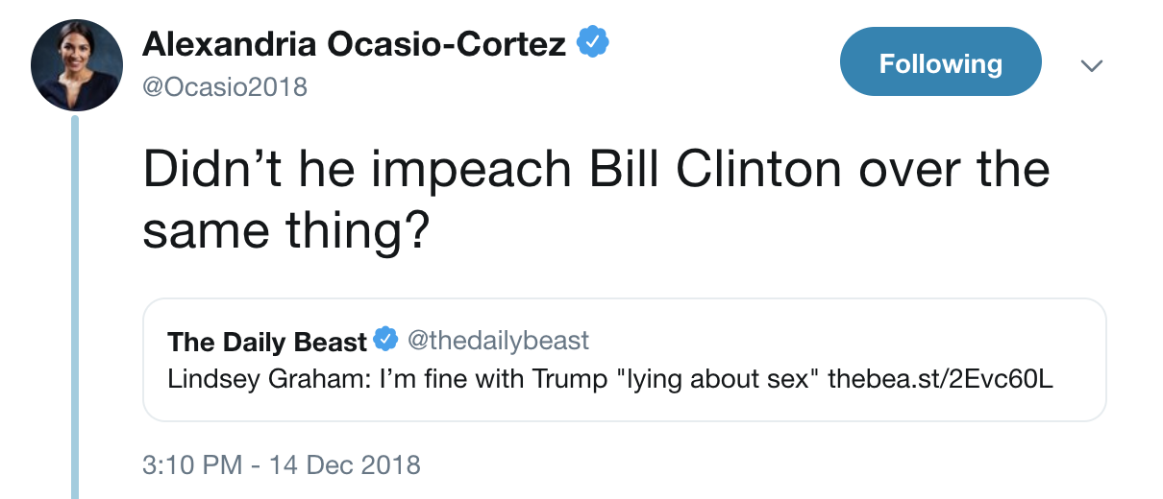
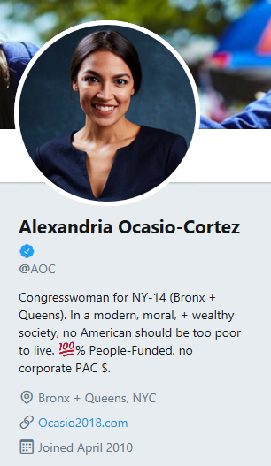
Previous Twitter Handles

Slide 5
Known Twitter Handles
AOC – 29th December 2018 till present
Ocasio2018 – Known from May 22 2017 to 29th December 2018
Changed to
@ocasio2018
Changed to
@AOC
Handle unknown
2010
@AOC 2019 Feb
2011
2012
2013
2014
2015
2016
2017
2018
May 22
Dec 29th
Timeline of Alexandria Ocasio Cortez Twitter Handles

Slide 6
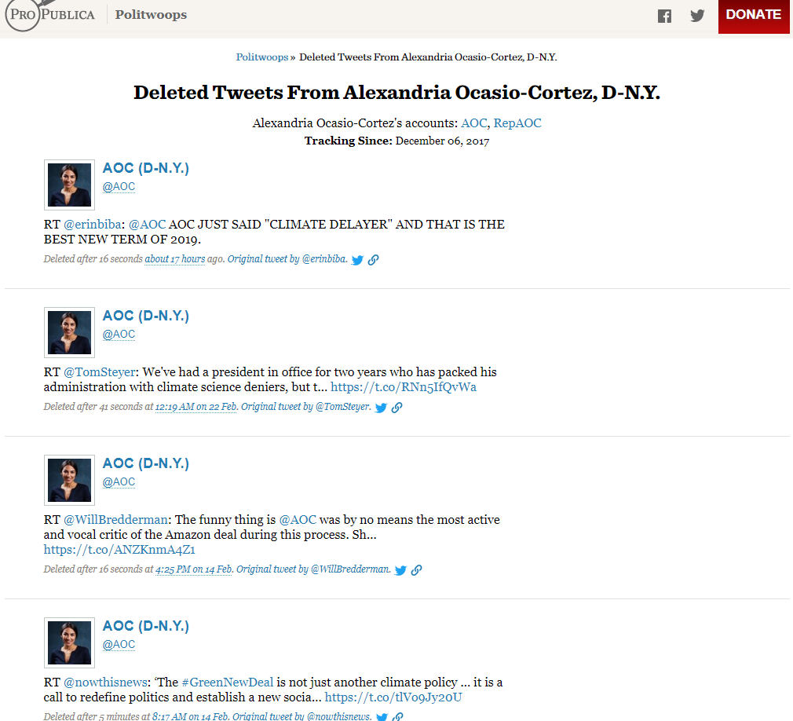
POLITWOOPS
URL: https://projects.propublica.org/politwoops/user/AOC

Slide 7
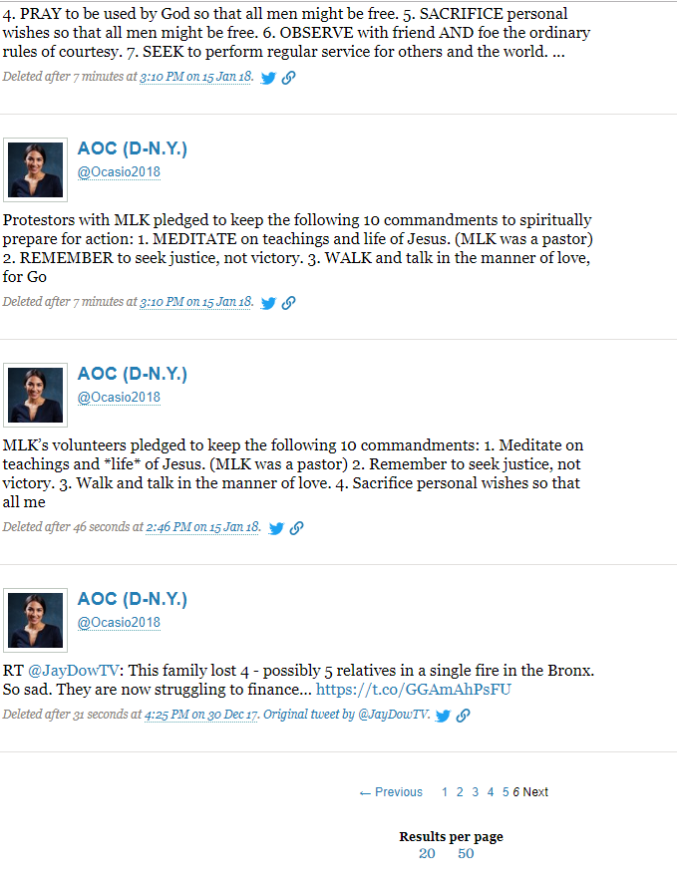
Last recorded earliest deleted Tweet
URL: https://projects.propublica.org/politwoops/user/AOC?page=6

Slide 8
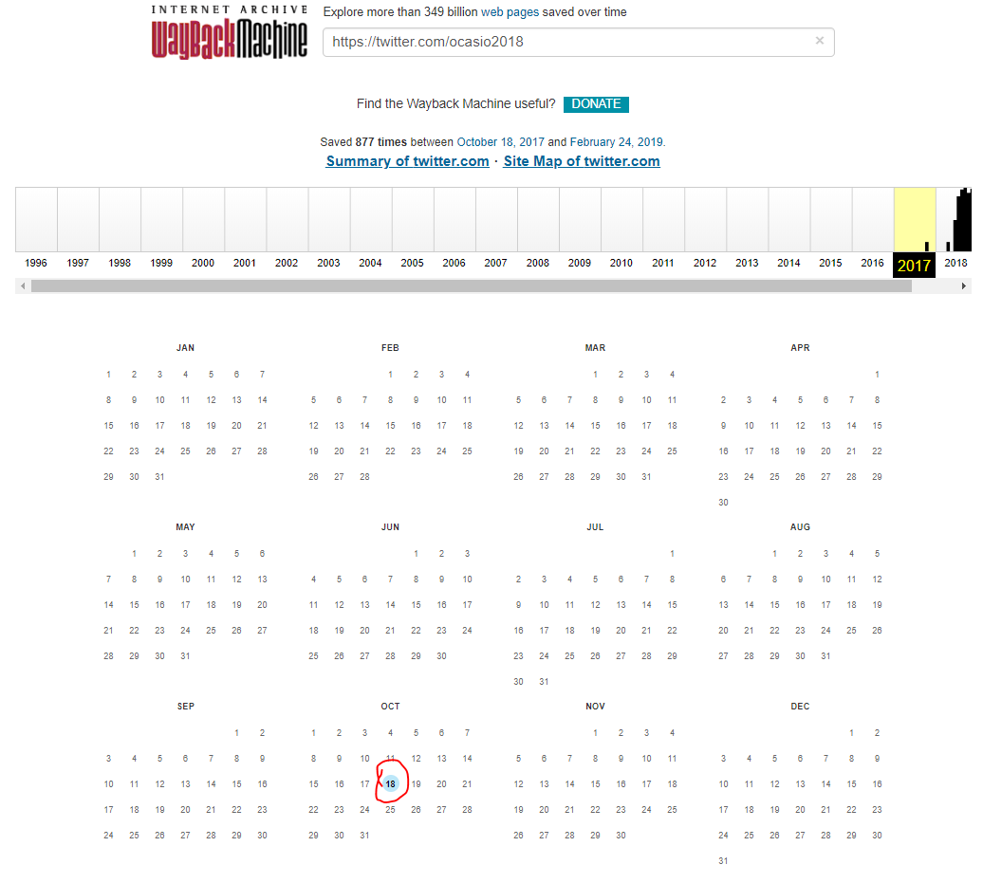
Only one Memento for Ocasio2018 in 2017
URL: http://web.archive.org/web/20170701000000*/https://twitter.com/ocasio2018

Slide 9
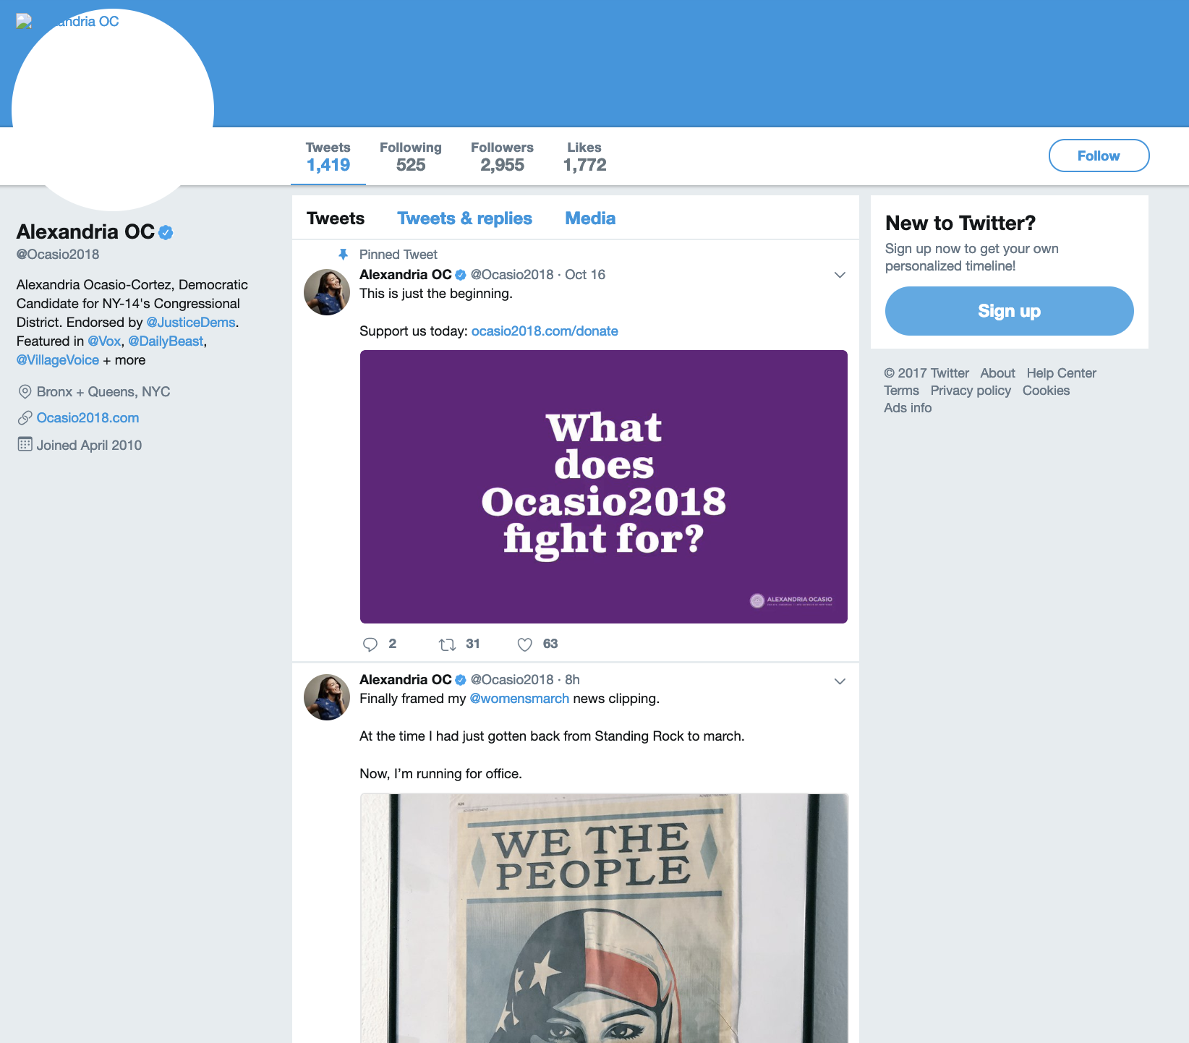
@ocasio2018 – Oct 18th 2017
URL: http://web.archive.org/web/20171018034720/https:/twitter.com/ocasio2018?lang=en

Slide 10
Handles from Her Only Memento of 2017
@womensmarch - present
@OurPoliticalRev - present
@NYPANetwork - first memento on Dec 7th 2017
@CarmenYulinCruz - mementos after September 30 2017
@DumbAllOverPod/ @ChristineNY09/ @HispCoalitionNY - no mementos
@ocioanderson5/HouseDemocrats/HouseGOP - account not found
@ocasio2018.com – Few Mementos found

Slide 11
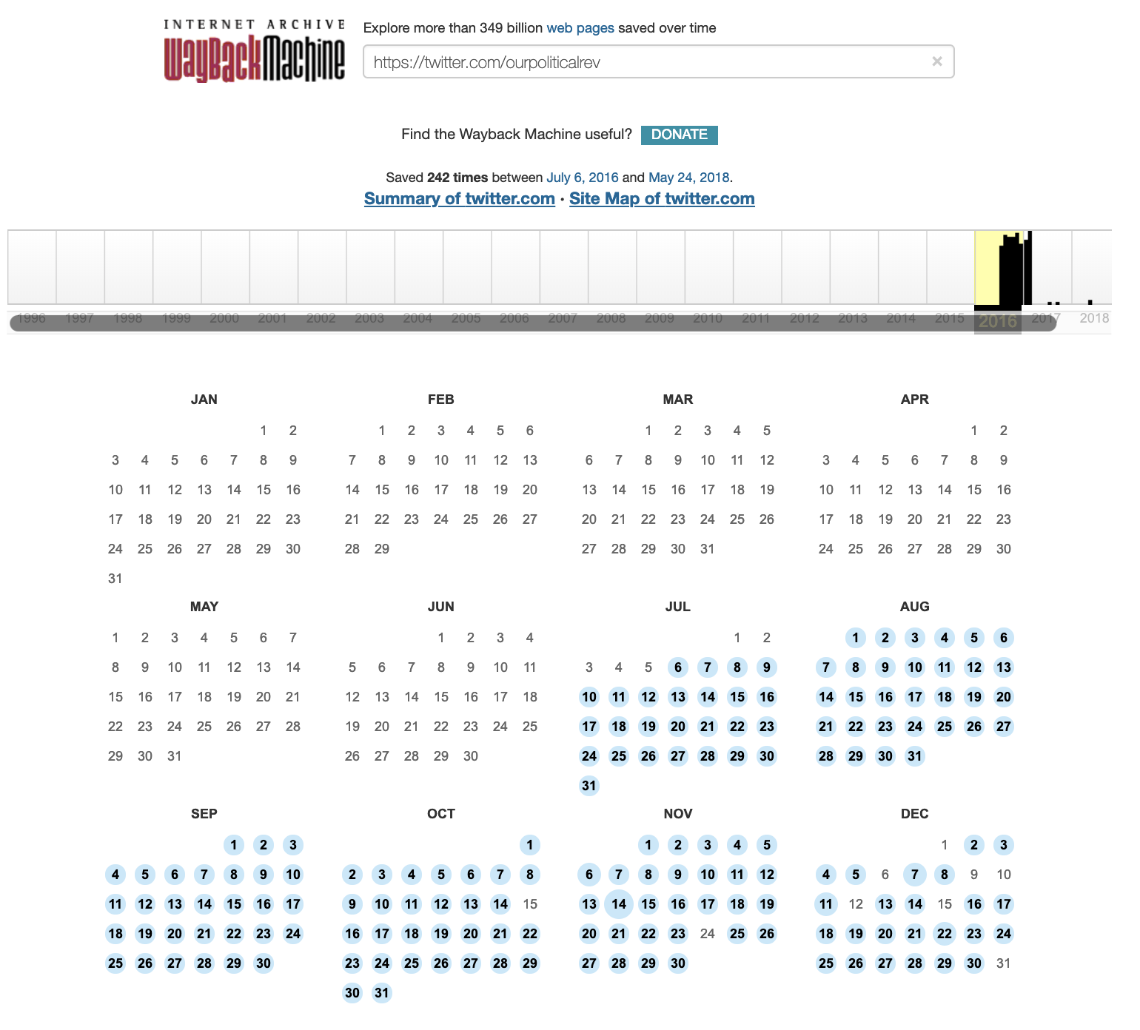
@ourpoliticalrev
URL: http://web.archive.org/web/20160601000000*/https://twitter.com/ourpoliticalrev

Slide 12
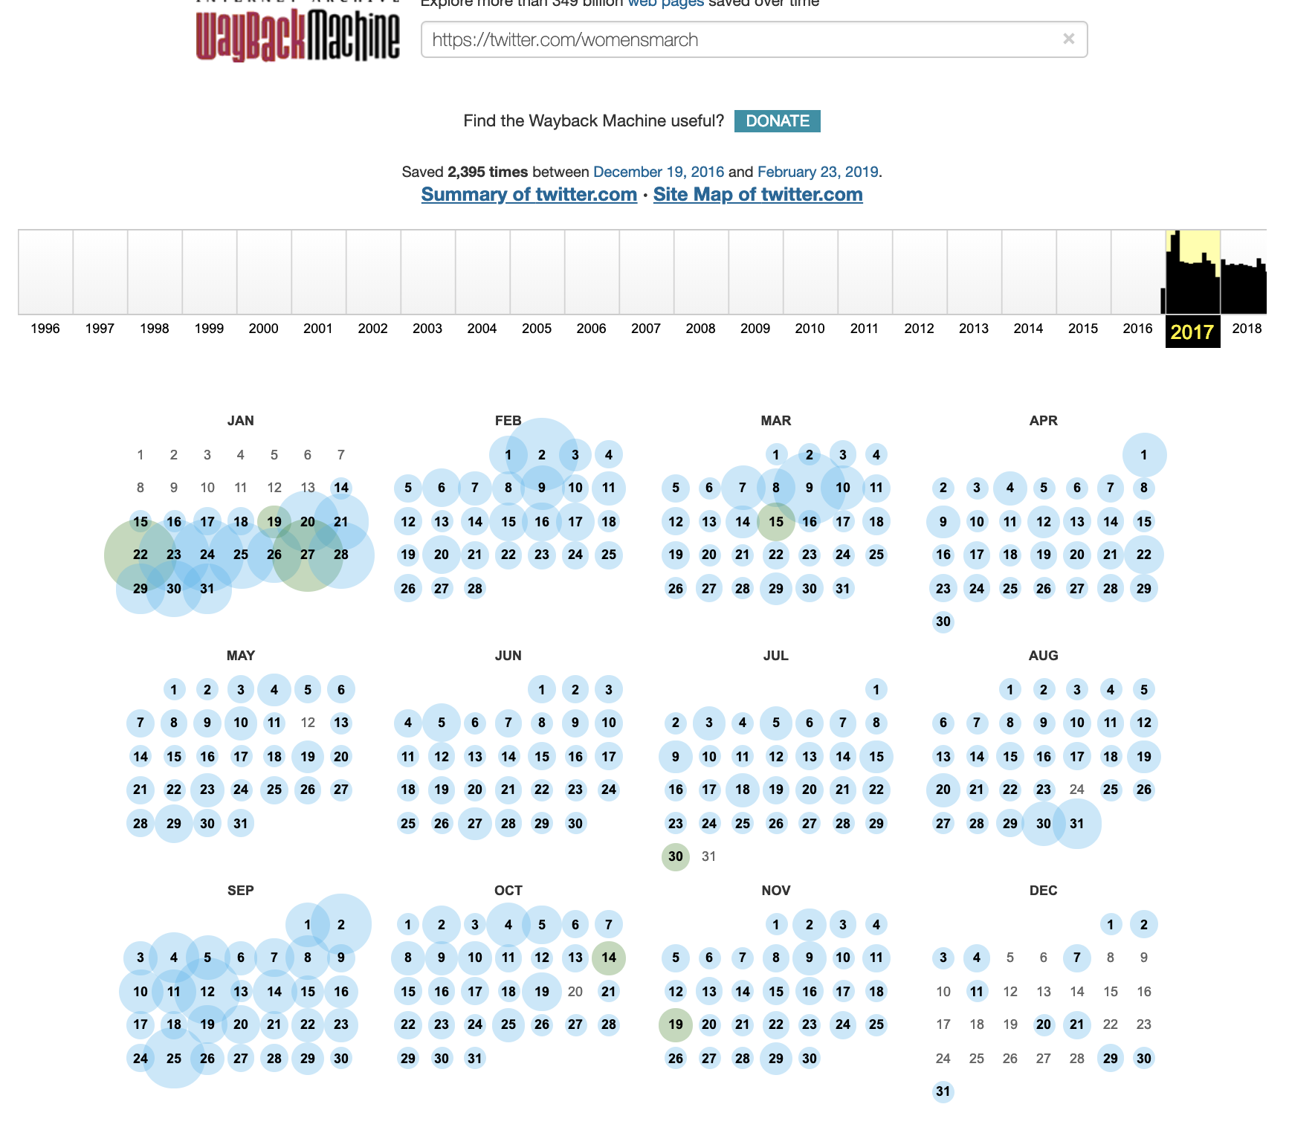
@womensmarch
URL: https://web.archive.org/web/20170601000000*/https://twitter.com/womensmarch

Slide 13
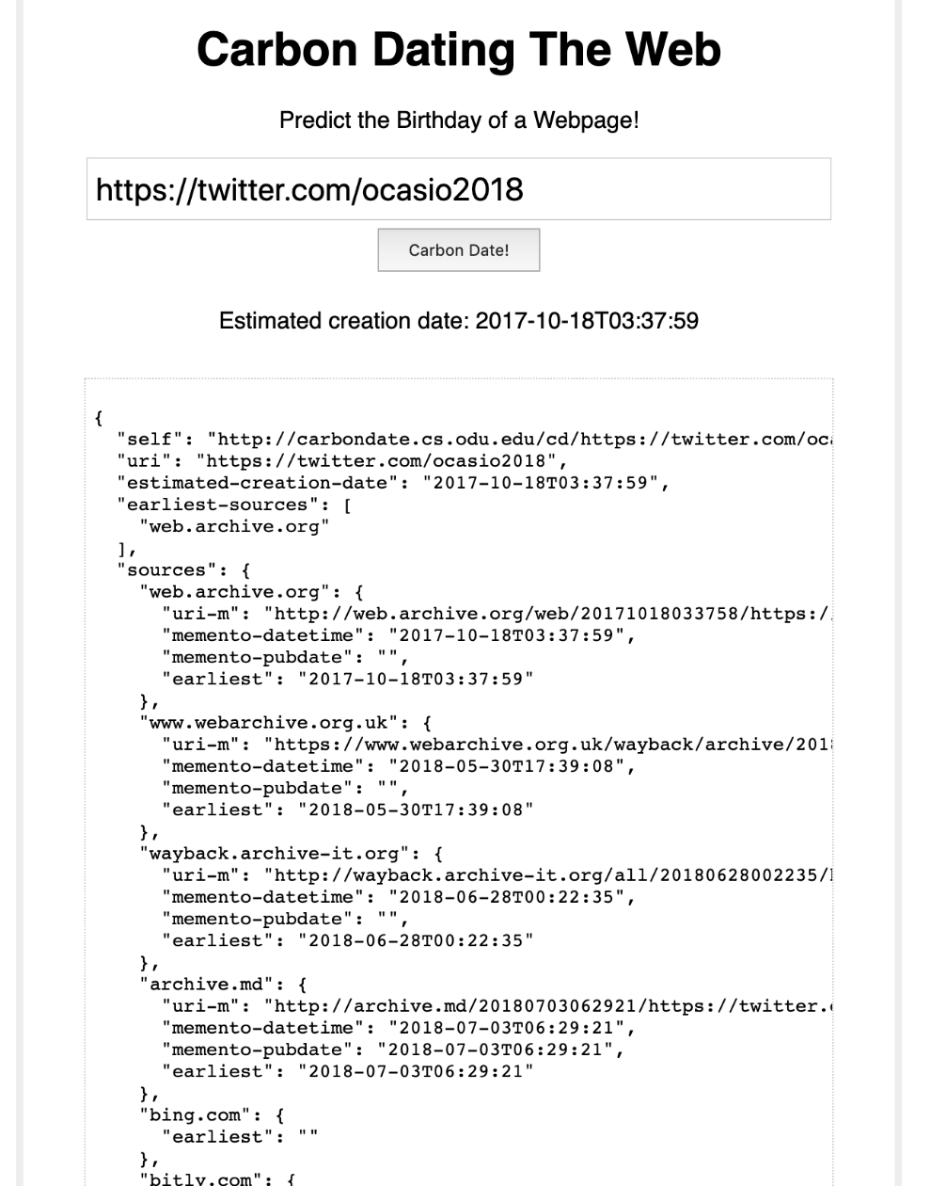
Carbon date of Casio2018
URL: http://carbondate.cs.odu.edu/#https://twitter.com/ocasio2018

Slide 14
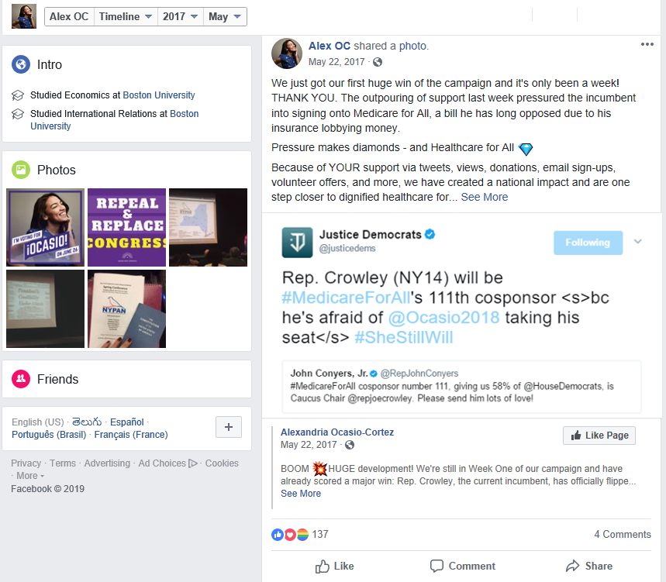
First reference to Twitter
URL: https://www.facebook.com/Ocasio2018/photos/a.1328091950614819/1334056826684998/?type=3&theater

Slide 15
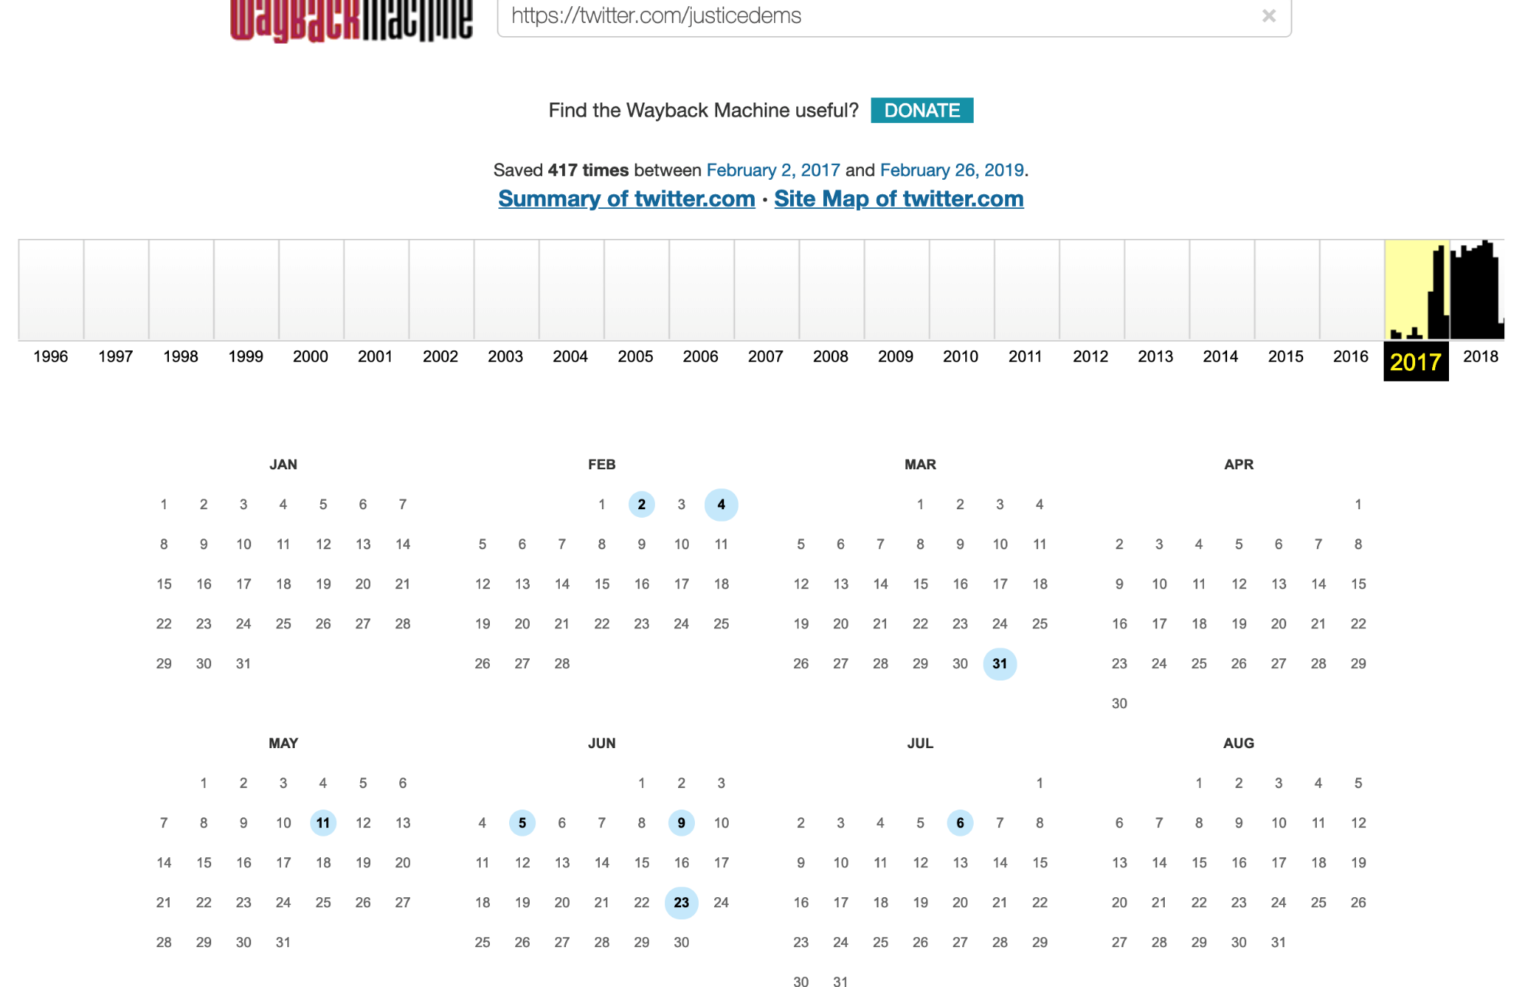
No Memento for @justicedems
URL : https://web.archive.org/web/*/https://twitter.com/justicedems

Slide 16
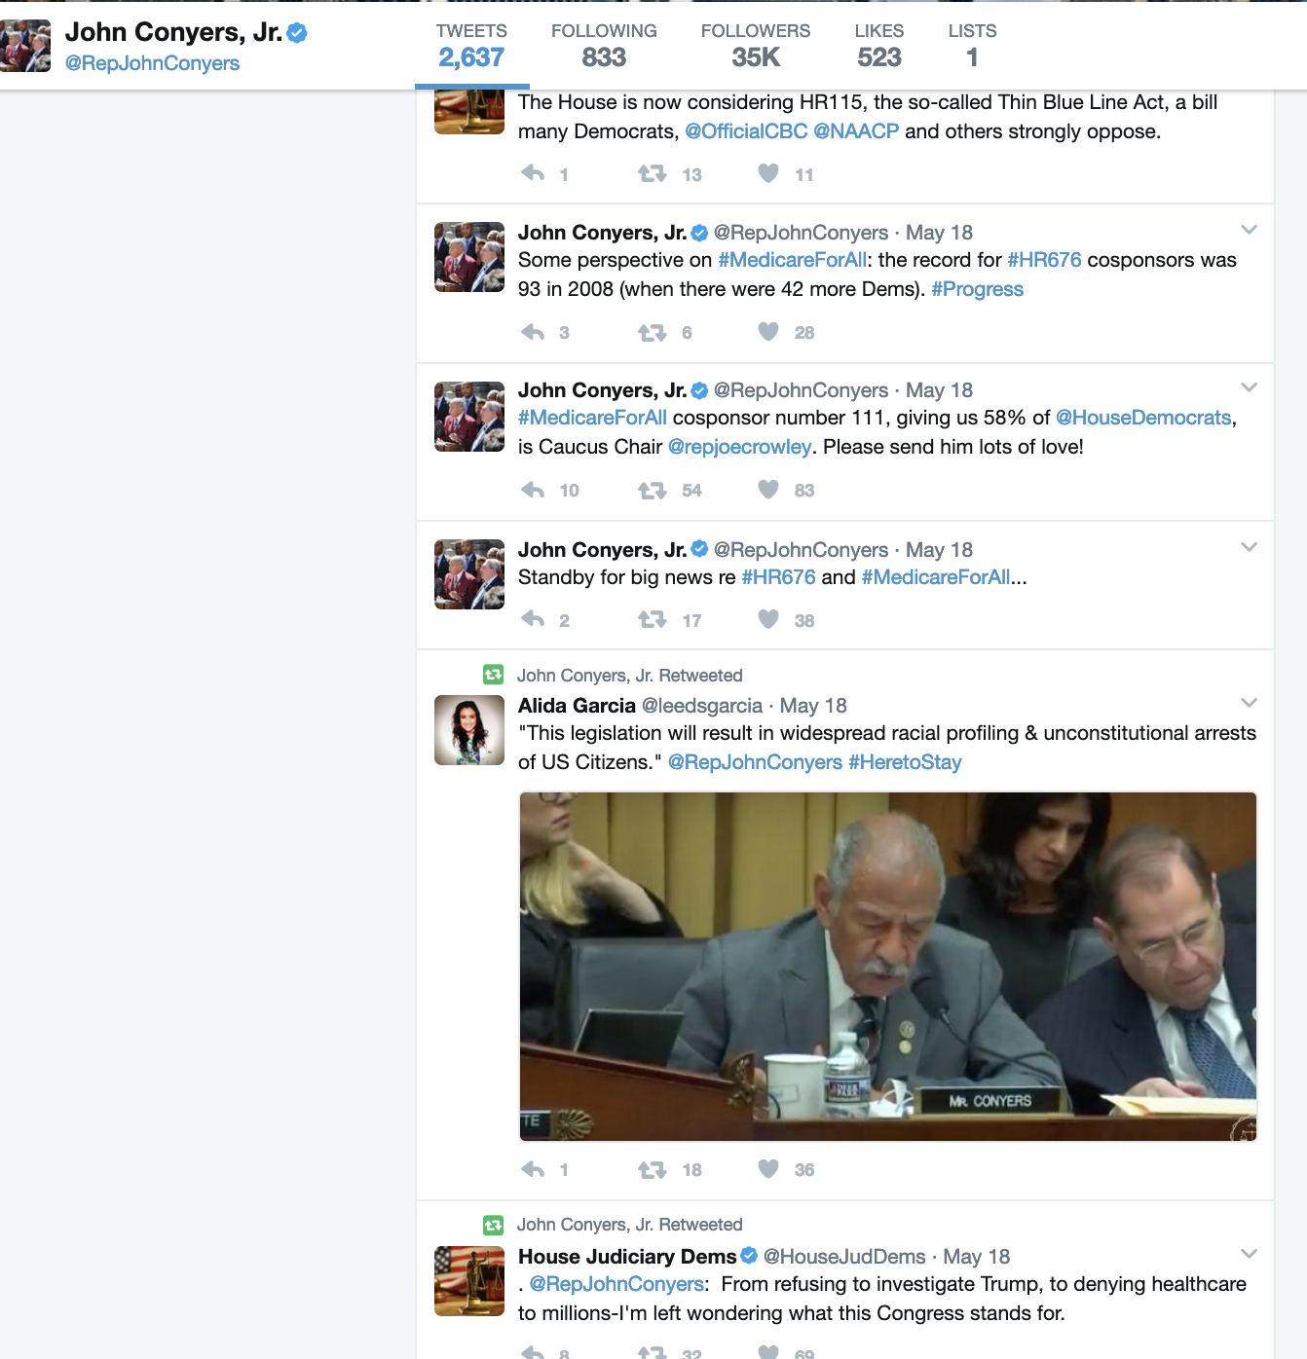
@repjohnconyers
URL: https://web.archive.org/web/20170525143311/https://twitter.com/repjohnconyers

Slide 17
Other Possible Source of Information
Social Media
Twitter
Facebook
Instagram
Snapchat

Slide 18
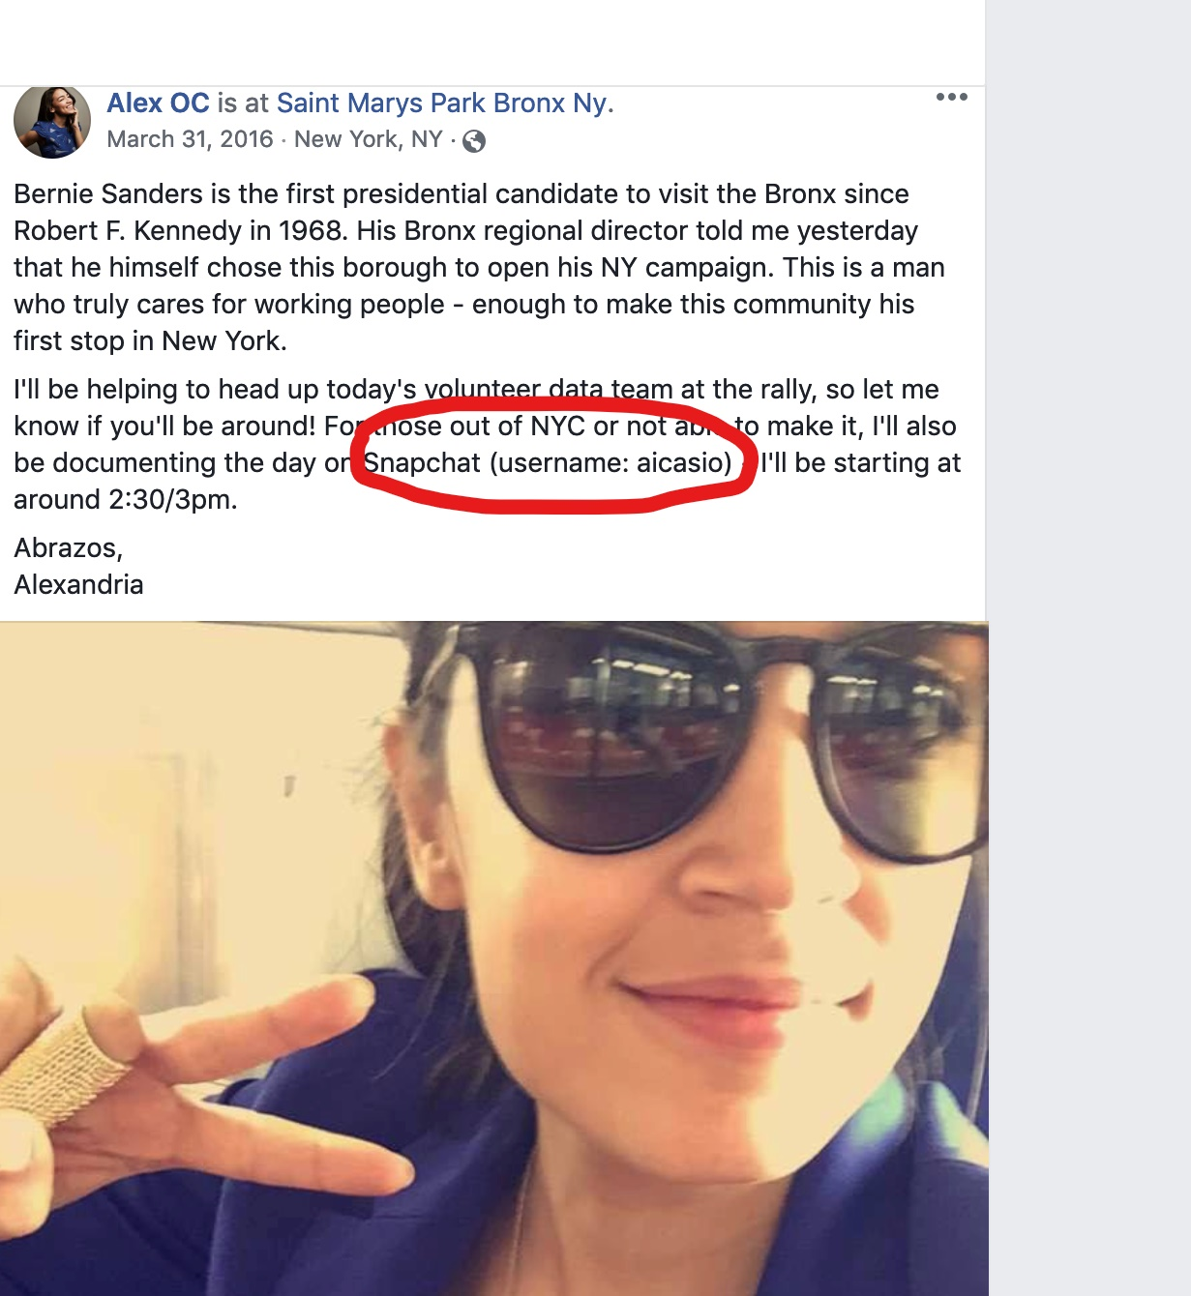
First References to other Social Media
URL: https://www.facebook.com/photo.php?fbid=10205813386398749&set=a.1171123083140&type=3&theater

Slide 19
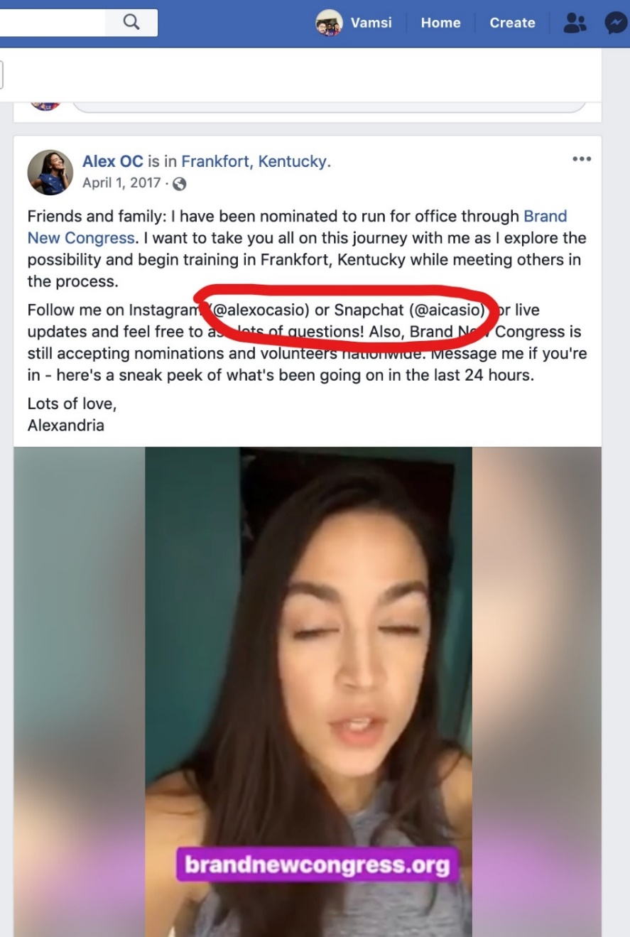
Another Reference before May 22
URL: https://www.facebook.com/alexandria.ocasiocortez/videos/10208330592767335/

Slide 20
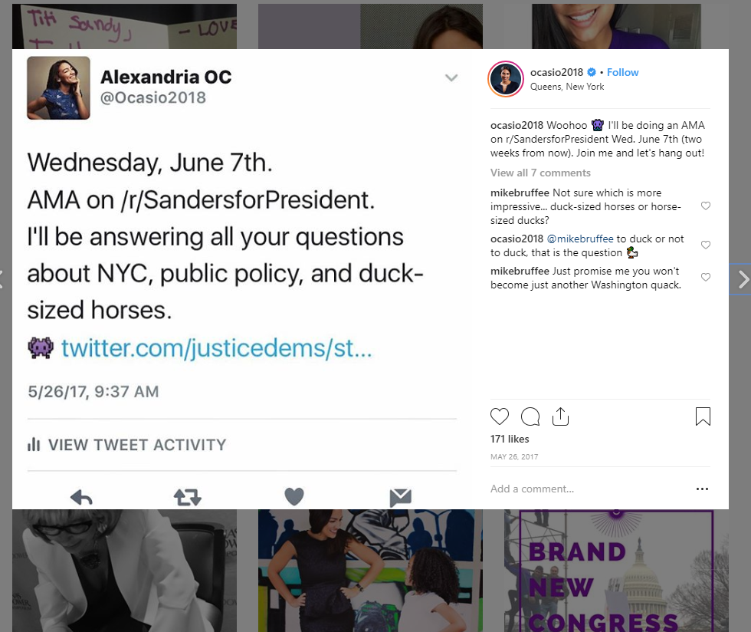
First Reference to Twitter on Instagram

Slide 21
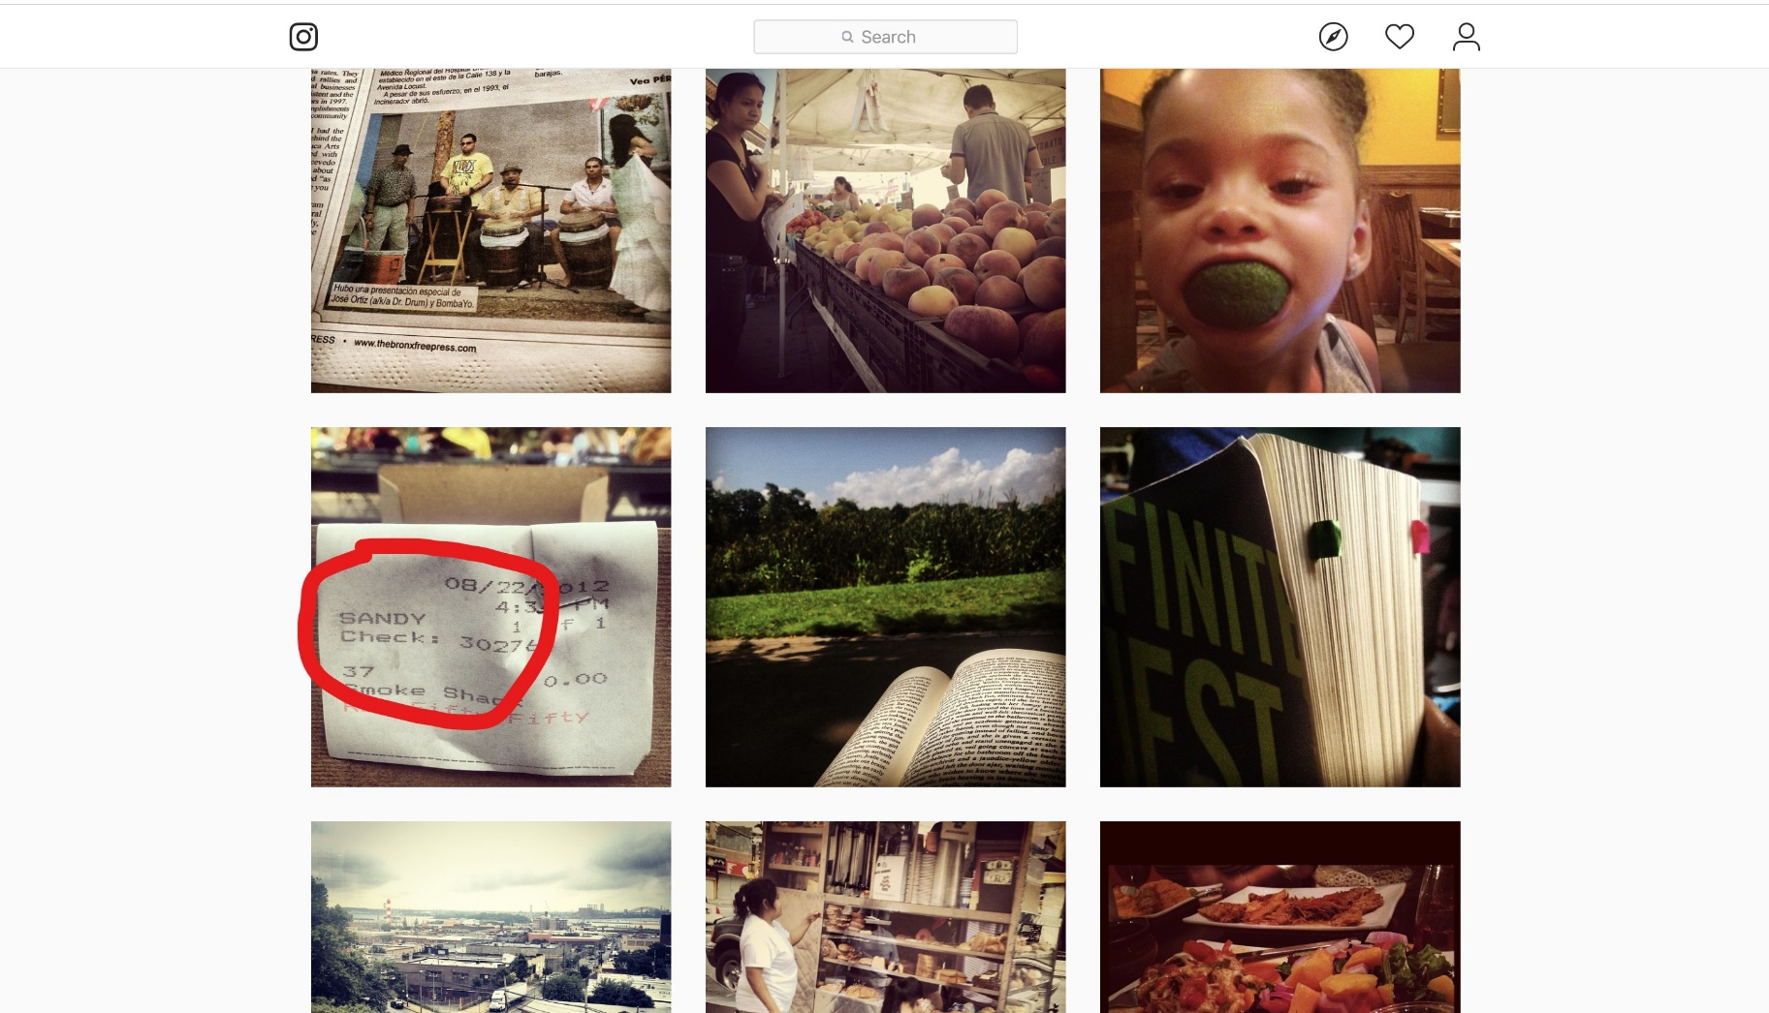
Random search for Possible Handles
URL: https://www.instagram.com/ocasio2018/

Slide 22
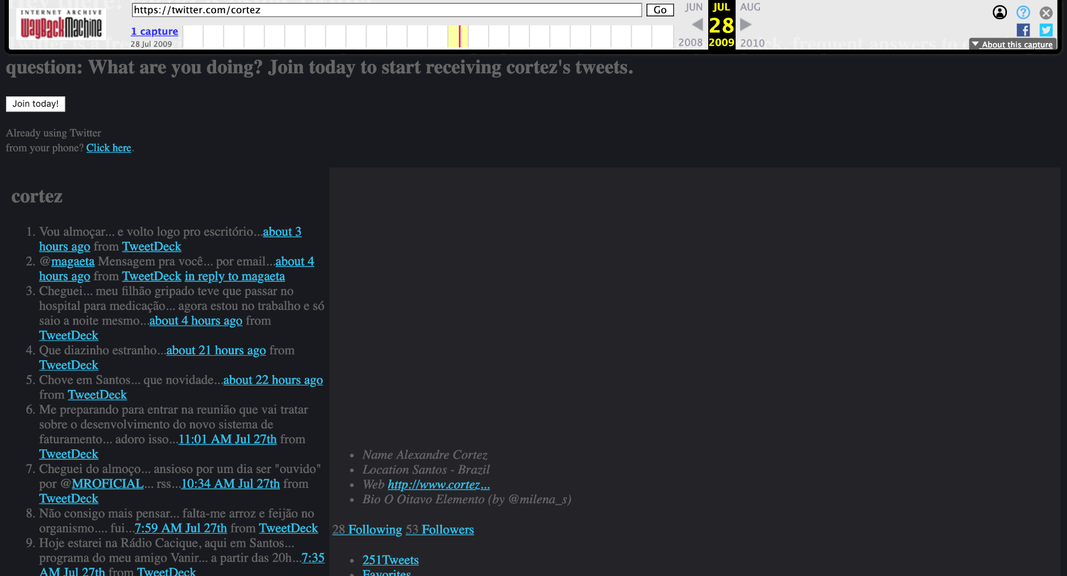
Roadblock – Memento in Flux/Broken Links
URL: http://web.archive.org/web/20090728183032/https://twitter.com/cortez

Slide 23
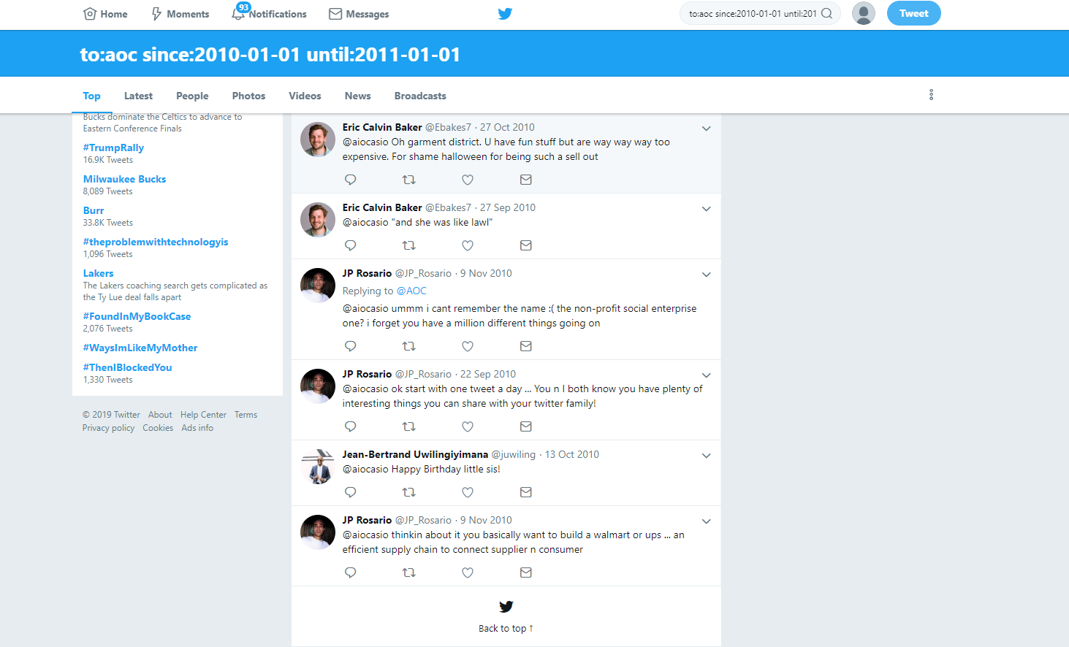
Advanced twitter search to the rescue
https://twitter.com/search?l=&q=to%3Aaoc%20since%3A2010-01-01%20until%3A2011-01-01&src=typd&lang=en

Slide 24
Conclusion
Available source of Archived Information is less
All available Memento’s of known sources that might point to her previous twitter handles in the Wayback Machine were taken after she came into fame
Advanced twitter search gave a way for her handles
Her twitter handle as of 2010-10-27 is “@aiocasio”

